Slide 1

LEGO PROJECT
Design of Experiment to IDENTIFY BEST PARAMETERS FOR THE CAR
Harshal Gajera
Michelle Leone
Pragya Nepal
Abhishek
12-08-2023

Slide 2


Problem Understanding
Create a Lego race car using a designated Lego kit and a provided Bill of Materials (BOM) that outlines the costs of each component
Employ a Designed Experiment methodology and accompanying analysis to determine the optimal design
Overarching goal is to enhance the distance the car travels down a pre-constructed ramp,

Slide 3
Factors Considered
Tire Size
Affects surface contact, influencing friction and overall speed
Length of the Car
Influences aerodynamics, stability, and weight distribution during descent.
Tire sets (2 or 3 sets)
Influences overall friction and stability, with more sets potentially increasing traction but also rolling resistance
01
02
03
04
05
Load Position (Front/Back)
Determines weight distribution, impacting balance and traction
Height of the Car
Alters the center of gravity, affecting stability and potential for tipping

Slide 4
Experimental Setup
Prerequisites
Constructed a standardized ramp with fixed dimensions and angle. Built a basic LEGO car using provided components along with multiple variation in design
Implementation
Systematically performed one run at a time with the randomized factor levels & orders generated from Minitab. Recorded the distance traveled after each descent
01
02
Data Collection
Utilized a tape measure for precise distance determination and recorded data systematically for each variation
03
Optimization
Performed Design of Experiment using Minitab to identify the relevant factor and thus build a robust design model
04
Randomization
Replication
Two replication with One-half experiments
32 Random order for experiment using MiniTab

Slide 5
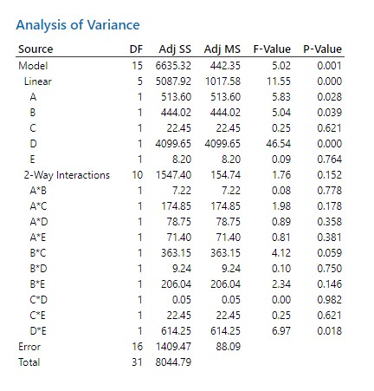

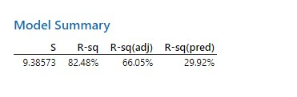
Before Optimization | Analysis of variance
Based on the raw data, only 66% of the variability was explainable as seen in the Rsq (adj) value
Similarly, the R-sq (pred) value was also low showcasing below average predictions

Slide 6
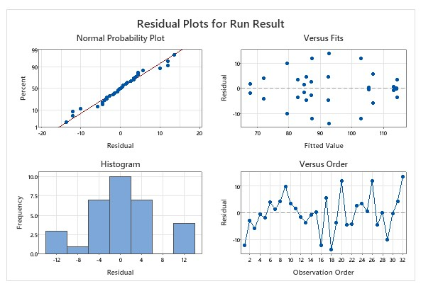
Before Optimization | Residuals Analysis
Certain Pattern were observed while testing the variability of residuals, where end points are comparatively thinner than mid-regions

Slide 7
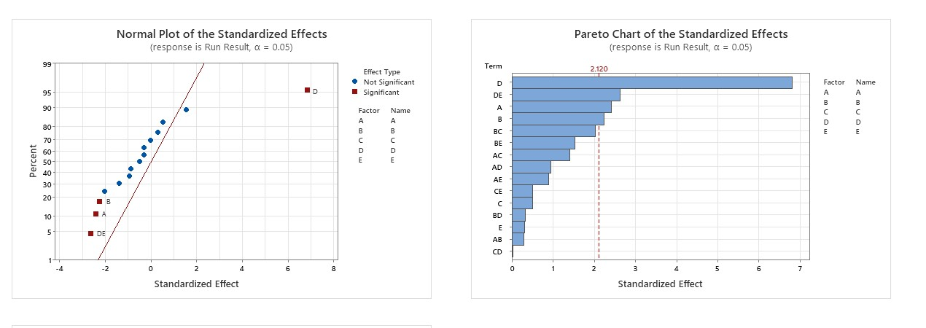
Before Optimization | Significance Test
Based on the Normal Plot, Factors A, B, D and DE were identified as significant factors

Slide 8
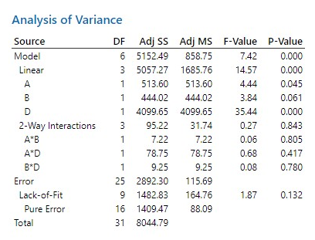
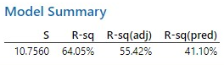
After Optimization | Considering Significant Factors
Despite reducing multiple no. of factors, the overall value of R-sq pred showed an improvement from 30% to 41%

Slide 9
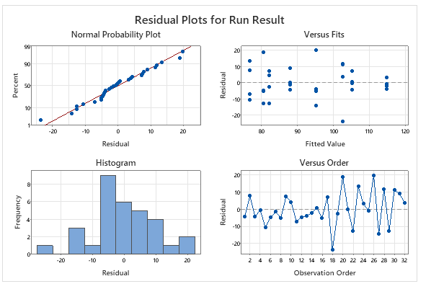
After Optimization
Similarly, there is now no strong pattern in residuals variance showcasing an improved performance

Slide 10
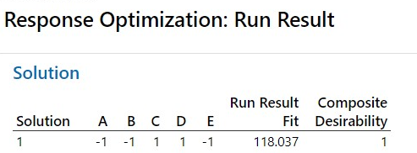
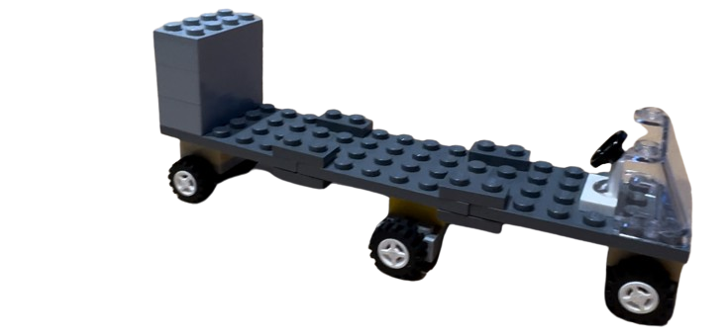
Final Car Model Used In The Race
The final optimized model was built by considering:
Height: Low(-1)
Tire Size: Low(-1)
Tire Sets: High(1)
Length: High(1)
Load Position: Low(-1)
THANK YOU!!

Slide 11
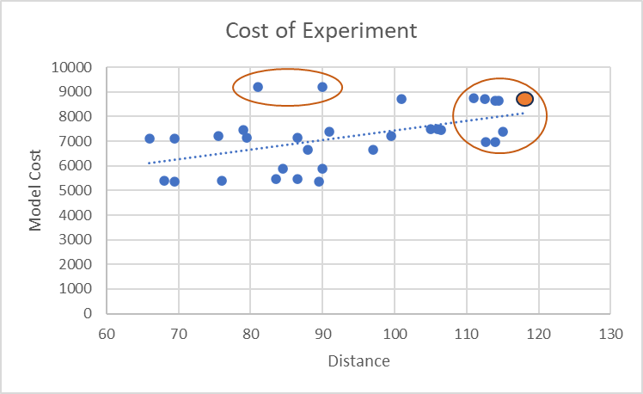
Cost of Experiment
Model highlighted in the graph shows that our optimal car which helps us to cover the maximum distance, cost us $8400 and can help us to cover 118cm distance

Slide 12
The final optimized model was built by considering:
Length:
Height:
Tire Size:
Load Position:
Tire Sets:
THANK YOU!!

